Slide 1
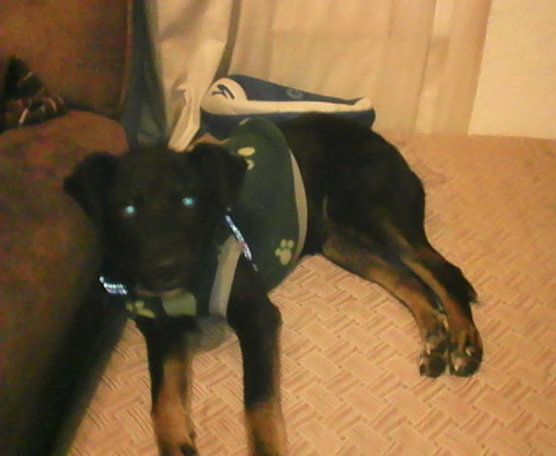
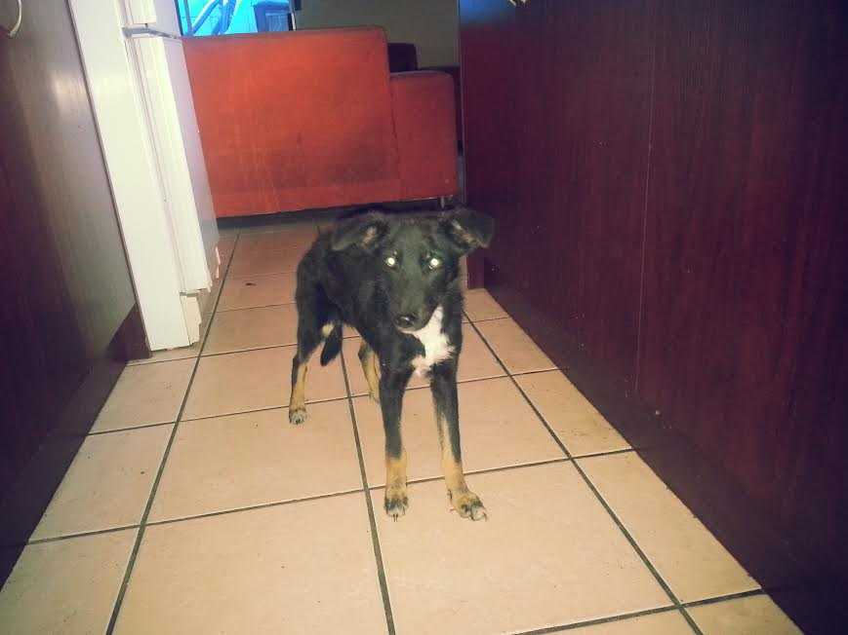
ZUES 10mth MALE TOY POM X
ZUES IS A LOVELY BOY LOOKING FOR HIS FOEVER HOME. HE IS 10MONTHS OLD, GOOD WITH KIDS AND OTHER PETS, HE IS A BIT SCARED AND IN DESPERATE NEED OF LOTS OF TLC FROM A FAMILY WILLING TO ADOPT HIM.
CONTACT: TARA 084 6257431 warmheartshappypaws@gmail.com
for any queries or if you would like to make a personal donation

Slide 2
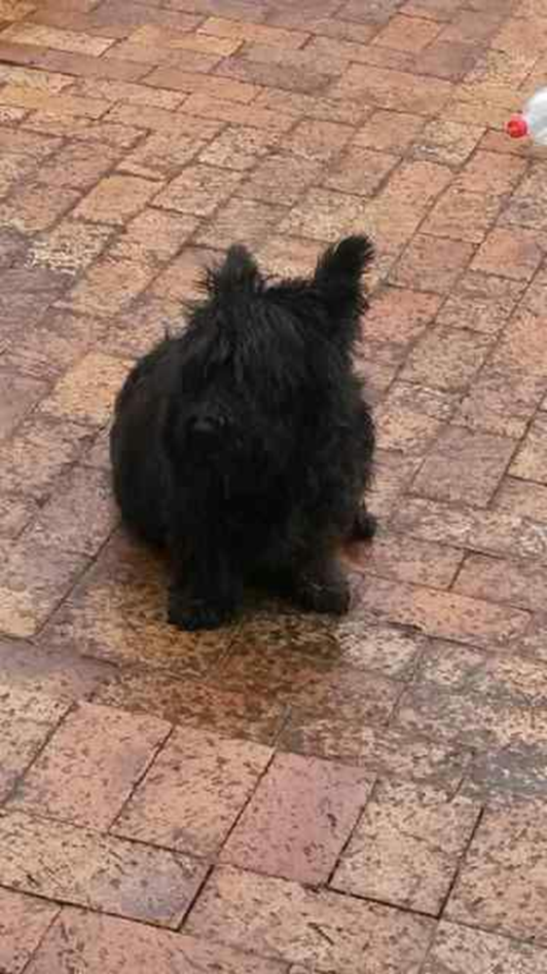
MILEY 5 YEAR SCOTHISH TERRIER
MILEY IS A GENTLE AND LOVING OLD SOUL, CONTENT TO LAY ON HER PILLOW AND RELAX IN THE COMPANY OF HER HUMAN FAMILY, HER AND HER SISTER ARE KID, CAT AND OTHER DOG FRIENDLY.
ADOPTED
CONTACT: TARA 084 6257431 warmheartshappypaws@gmail.com
for any queries or if you would like to make a personal donation

Slide 3
KELLY 5 YEAR SCOTHISH TERRIER
KELLY IS A GENTLE AND LOVING OLD SOUL, CONTENT TO LAY ON HER PILLOW AND RELAX IN THE COMPANY OF HER HUMAN FAMILY, HER AND HER SISTER ARE KID, CAT AND OTHER DOG FRIENDLY.
ADOPTED
CONTACT: TARA 084 6257431 warmheartshappypaws@gmail.com
for any queries or if you would like to make a personal donation

Slide 4
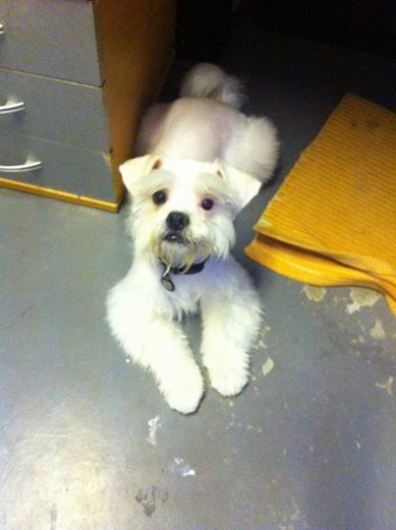
NOODLE 1 YEAR MALTEZE X
NOODLE IS A PLAYFUL YOUNG FELLOW WHO LOVES KIDS AND OTHER PETS, IS GREAT TO CUDDLE WITH. HE IS WELL BEHAVED, VERY PLAYFULL AND LOVABLE, BUT NEEDS TO BE IN A FULLY ENCOLSED PROPERTY AS HE HAS THE TENDANCY TO RUN. BUT HE IS BEAUTIFUL AND HEALTHY BOY
ADOPTED
CONTACT: TARA 084 6257431 warmheartshappypaws@gmail.com
for any queries or if you would like to make a personal donation

Slide 5
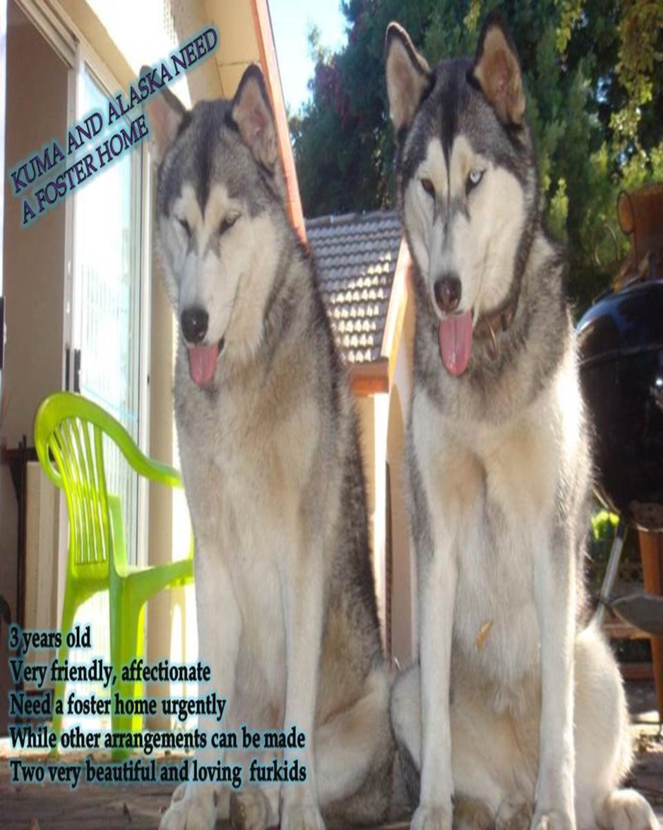
ALASKA AND KUMA 3 YEARS
STUNNING BROTHER AND SISTER.
FRIENDLY, AFFECTIONATE, WELL TRAINED, GOOD WITH KIDS, CATS AND OTHER DOGS, EXCELLENT COMPANIONS
ADOPTED
CONTACT: TARA 084 6257431 warmheartshappypaws@gmail.com
for any queries or if you would like to make a personal donation

Slide 6
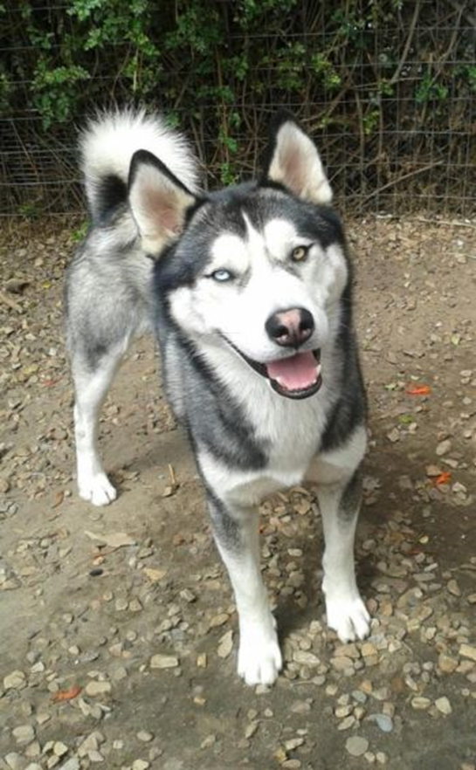
STORM 1 YEAR OLD HUSCKY
STORM IS A LOVELY BOY, WELL TRAINED, LOVE TO PLAY ANJOYS SLEDDING AND THE BEACH. HE IS A BIT OF A TALKER AND NEEDS CONSTANT ATTENTION.
ADOPTED
CONTACT: TARA 084 6257431 warmheartshappypaws@gmail.com
for any queries or if you would like to make a personal donation

Slide 7
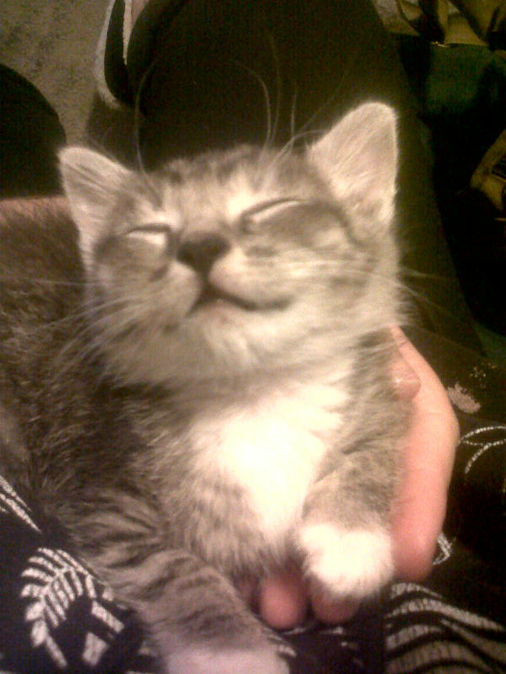
LEON 6 WEEKS OLD MALE
LEO IS A 6 WEEK OLD MINITURE KITTEN, HE WILL REMAIN SMALL HIS WHOLE LIFE, HE IS CUTE, CUDLEY AND OOH SO LOVABLE
ADOPTED
CONTACT: TARA 084 6257431 warmheartshappypaws@gmail.com
for any queries or if you would like to make a personal donation

Slide 8
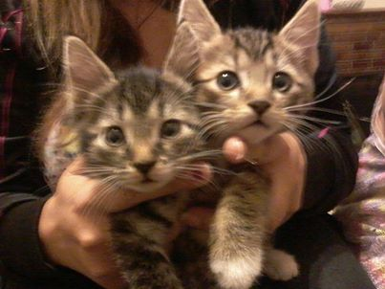
THE TWINS 9 WEEKS OLD
CUTE AND CUDLY BROTHER AND SISTER, FRIENDLY, PLAYFUL, ADORBLE KITTENS. VERY INQUISITIVE AND MISCHEVIOUS
ADOPTED
CONTACT: TARA 084 6257431 warmheartshappypaws@gmail.com
for any queries or if you would like to make a personal donation

